Slide 1


PASS Insights
August, 2019
Newsletter
Hiram Fleitas
Fleitas Arts
github.com/hfleitas/SentimentPrediction
Notes:
Image ref: https://talesofarcadia.fandom.com/wiki/Toby_Domzalski

Slide 2
Get Cognitive API
By Using Python & T-SQL
Azure Text Analytics API
SQL Server ML Services
Python & T-SQL
Custom Model
Realtime Scoring
Hiram Fleitas
Fleitas Arts
github.com/hfleitas/SentimentPrediction
Notes:
Image ref: https://talesofarcadia.fandom.com/wiki/Toby_Domzalski

Slide 3











Hiram Fleitas
Owner Fleitas Arts
Bio
Father
Principal DB Architect
Python since 2009
Developer since 1995
SQL Server since 1999
USCG Auxiliary Flotilla Staff Officer
@hiramfleitas
/hfleitas
hiram@fleitasarts.com
hiramfletias
fleitasarts.com

Slide 4
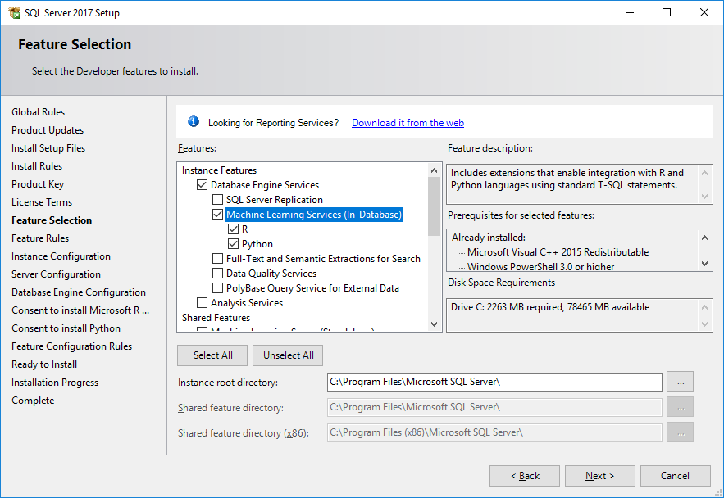

Slide 5
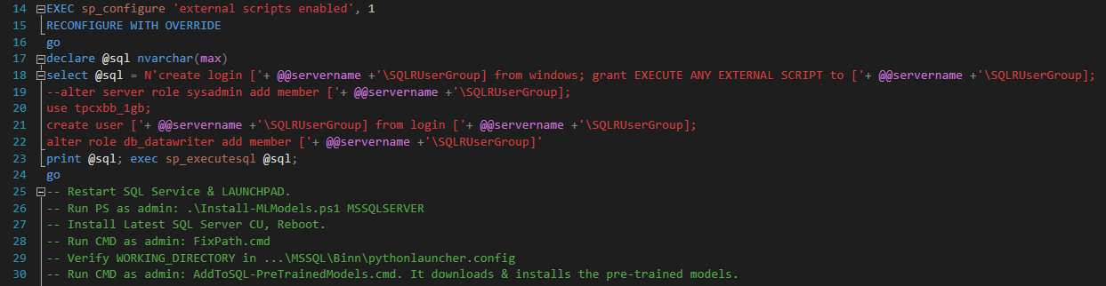

Slide 6
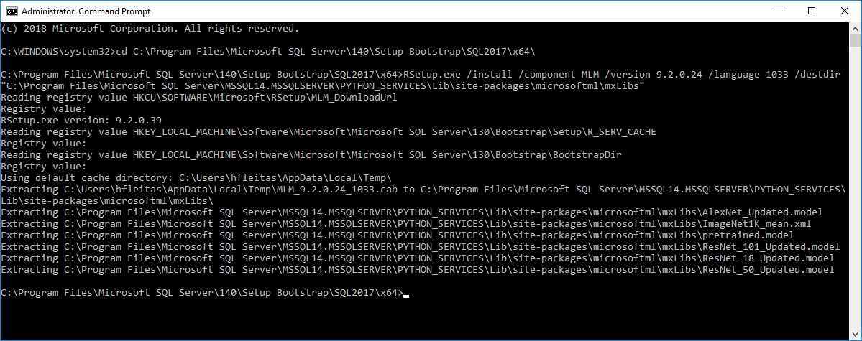
Notes:
rem 2019
cd C:\Program Files\Microsoft SQL Server\150\Setup Bootstrap\SQL2019CTP3.0\x64\
RSetup.exe /install /component MLM /version 9.4.7.0 /language 1033 /destdir "C:\Program Files\Microsoft SQL Server\MSSQL15.MSSQLSERVER\PYTHON_SERVICES\Lib\site-packages\microsoftml\mxLibs"

Slide 8
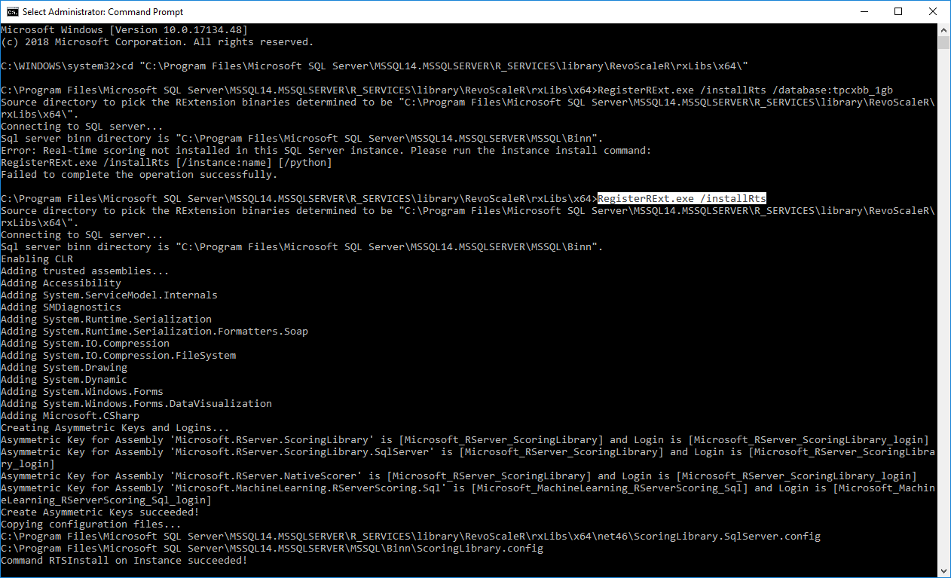

Slide 9
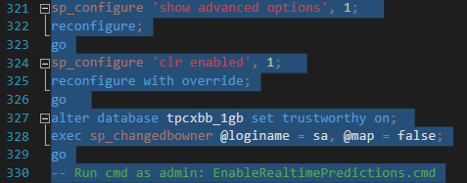

Slide 10
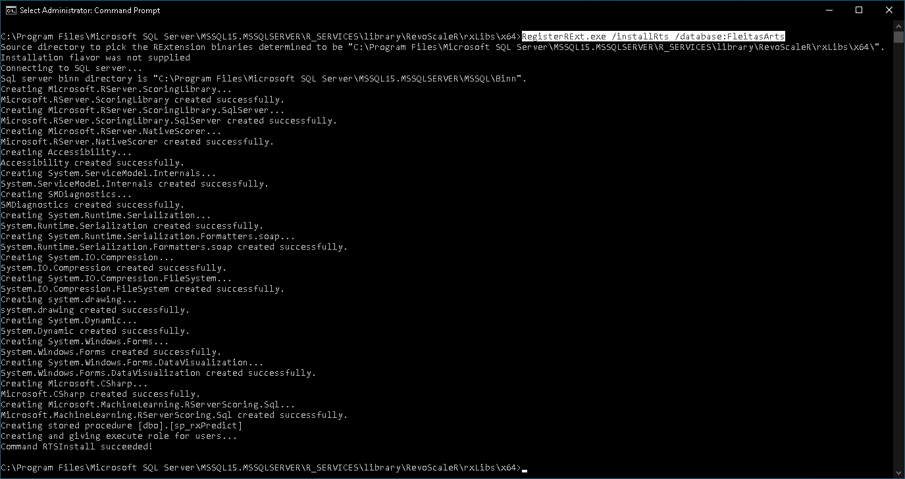

Slide 11
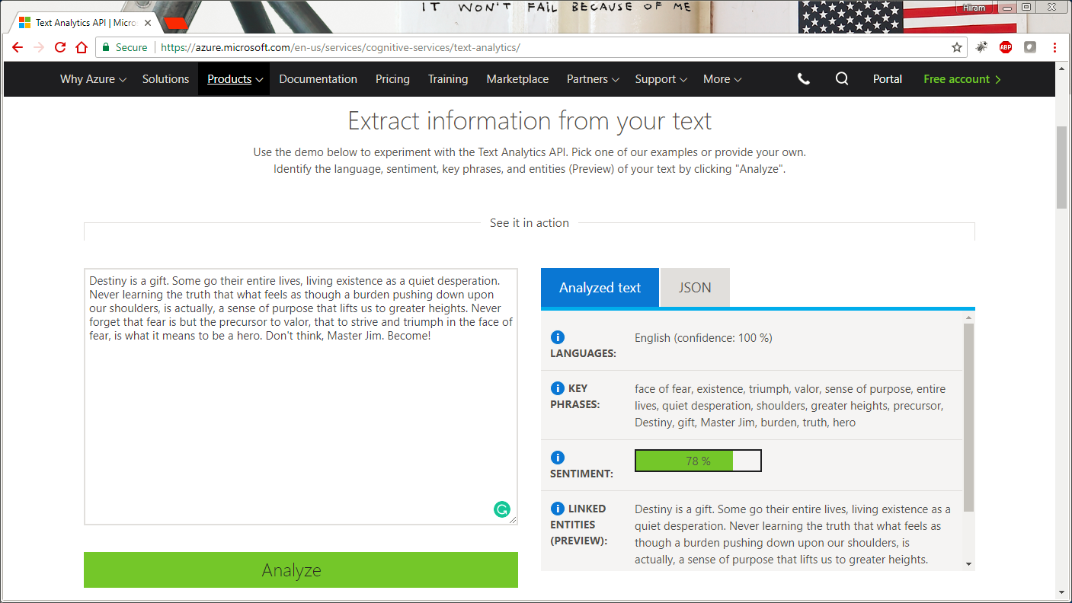

Notes:
https://netflix.com/trollhunters

Slide 12

DEMO
Notes:
https://netflix.com/trollhunters

Slide 13
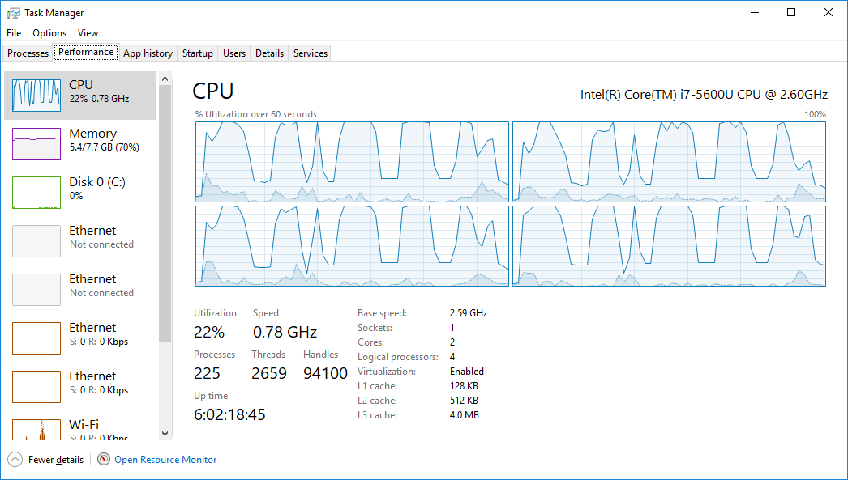

Slide 14
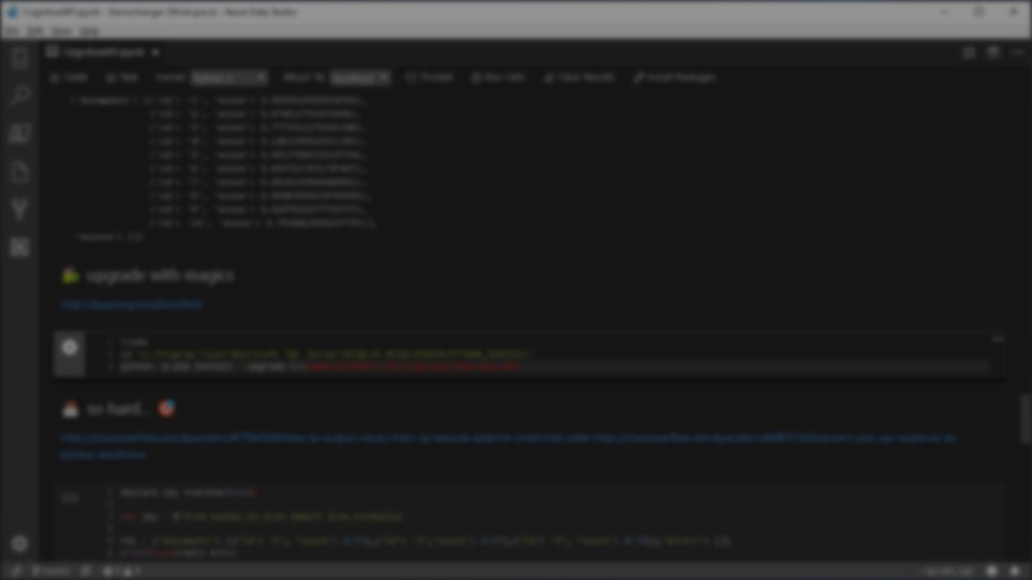


Summary
Setup
Azure Data Studio Notebook
Azure Cognitive Text Analytics API
JSON, Training & Test Views
Models Table
GetCognitiveAPIQuoteSentiment
GetTrollhunterModel
sp_RxPredict for Real-time predictions
Resources

Slide 15
Resources
fleitasarts.com
github.com/hfleitas/SentimentPrediction
netflix.com/trollhunters
SQL Server Machine Learning Services: Tutorials
Interactive deep learning: Learn alert
aka.ms/sqlworkshops
ailab.microsoft.com
SQL Server R Services Samples: Microsoft Repo
SQL Server Components for Python: Interaction of Components
Pre-Trained ML Models: Install in SQL Server
Threading ML: Logistic Regression
Azure SQL ML Public Preview: Sing up
pass.org/summit
Notes:
Image ref: https://talesofarcadia.fandom.com/wiki/Toby_Domzalski

Slide 16
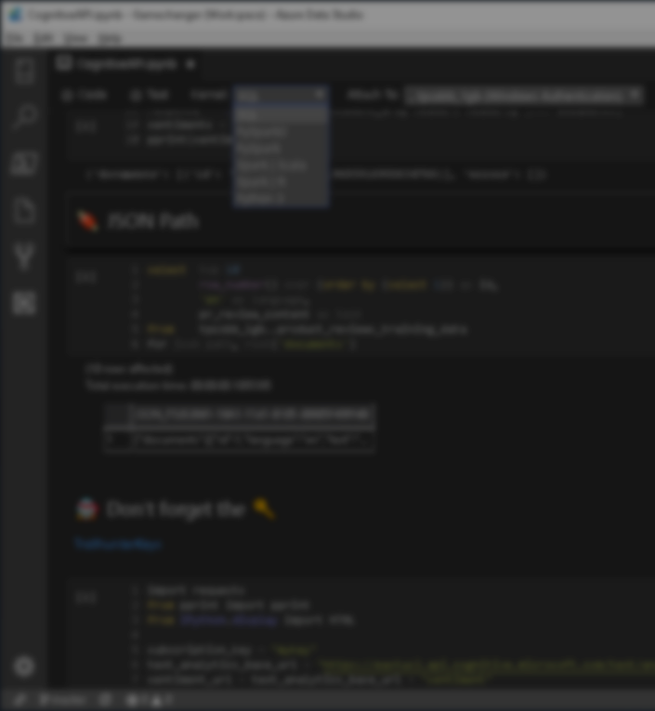

Session evaluations
This is the link:
bit.ly/azureML19
Your feedback is very important.
Submit your feedback by the end of this presentation.

Slide 17
Hiram Fleitas
Owner Fleitas Arts
@hiramfleitas
Thank You
hiram@fleitasarts.com
fleitasarts.com
/hfleitas
hiramfleitas

